Slide 1
Will you be accepted into a graduate program?
Thinkful Capstone 2 presentation

Slide 2

Background- finding the data
Started by looking at possible jobs that I would be interested in applying to. This then led to looking at available data sets to help form a question.
Job posted by: CollegeVine
The model that I created will be able to predict the chance of a student being accepted into graduate school based on GPA, GRE scores, and other factors.
Data set
Notes:
Maybe speak about your background a bit and talk about the actual job description which inspired you to do this project. Don't forget to speak about who will benefit from this project. Speak about the problem statement separately. Speak about the dataset and variables a bit.

Slide 3
Research question:
What are the chances that a student will be accepted into graduate school? What should a student focus on in order to increase his/her chances of being admitted?
The practical uses / audience of interest
Students will want to know what to focus on in order to be accepted into graduate school. Will it help to study for the GRE or focus on undergraduate studies to make sure grade point average is high?

Slide 4
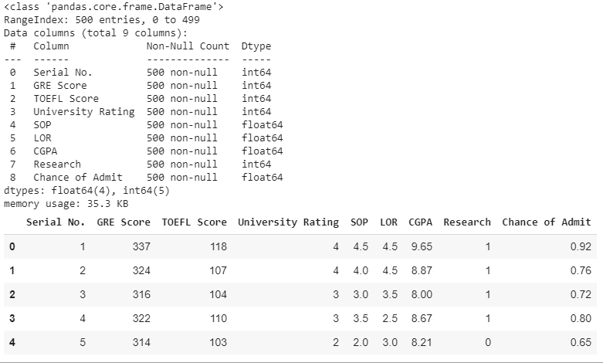
Data Exploration and Cleaning
Data cleaning point of interest: There are no missing values
Target variable (Chance of admit)
-is continuous
- this will need regression models

Slide 5
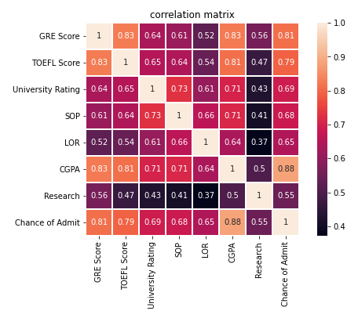
Correlation Matrix
Target feature: Chance of admit
Notes:
Serial Number was dropped, low correlation

Slide 6
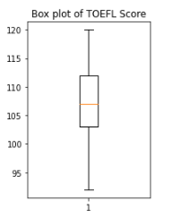
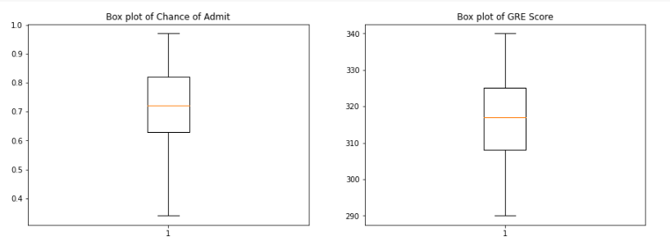
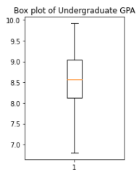
Looking for outliers

Slide 7
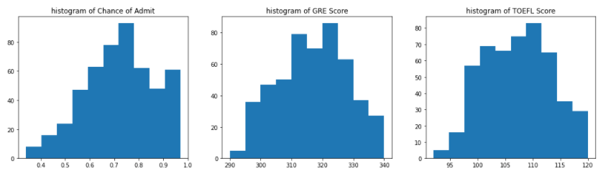
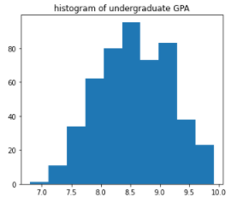
Feature Engineering- distribution of data

Slide 8
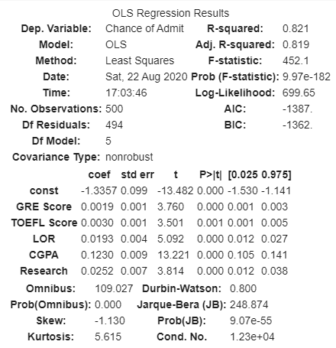
Initial model run
Note:
Coefficients are not comparable for relative importance. as they were not normalized
Variables will be normalized in the models.
Notes:
Needs more comments from you on model results interpretation - significance of variables / model / R-squared value / MAE / etc. Explain it to a non-tech audience.

Slide 9
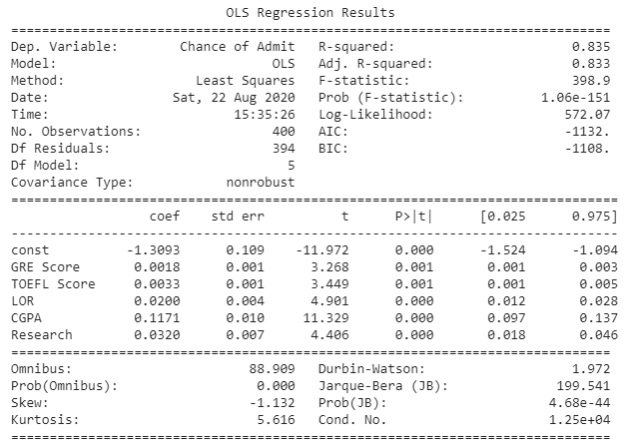
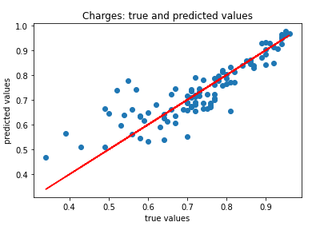
Linear regression model
Ridge, lasso, elastic net had similar results
All models are showing an R squared value of about 0.75 and Mean absolute error of 0.04
Notes:
Needs more comments from you on model results interpretation - significance of variables / model / R-squared value / MAE / etc. Explain it to a non-tech audience.

Slide 10
Thank you for your time!

